Slide 1
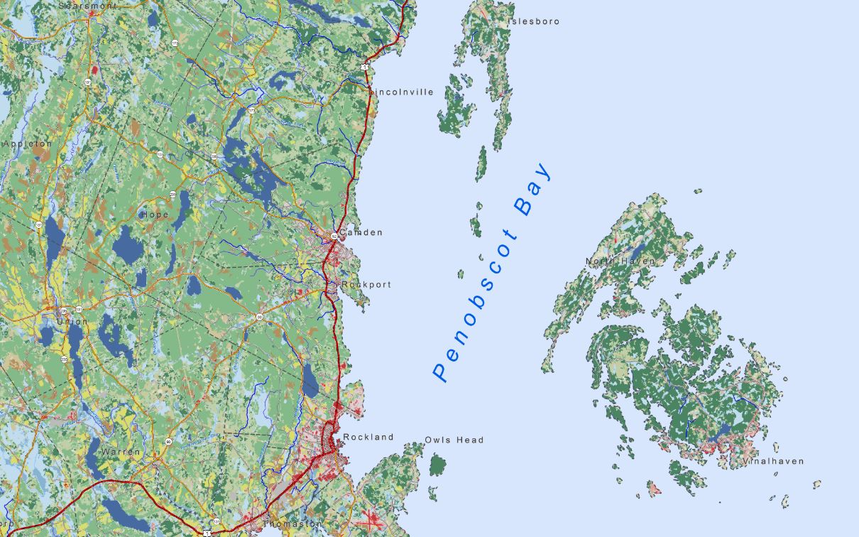
Friends of Penobscot Bay:
Tools for Assessing and Managing Human
Impact on Maine’s Harbors

Slide 2
Today’s Outline
Project Goals
Methods
Findings and Results
Conclusions
Recommendations for further research
Notes:
Beginning of audio

Slide 3
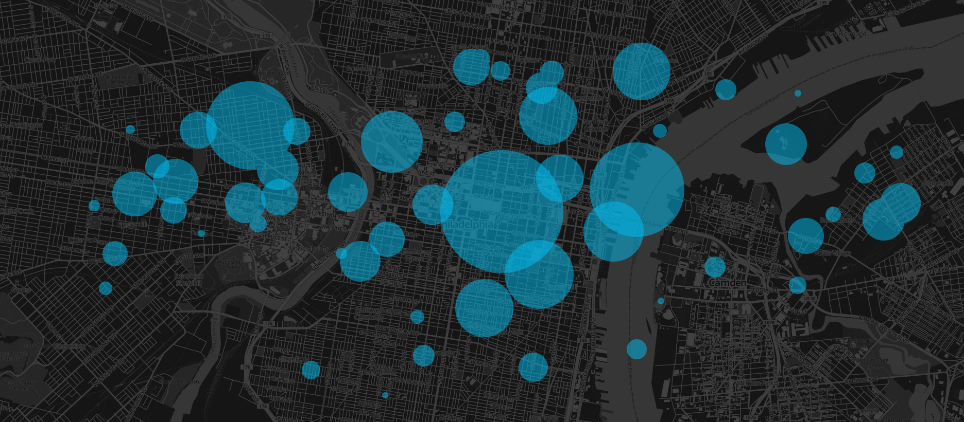
Civic Software, Data Analytics & Research

Slide 4
B Corporation
Civic / Social Apps
Pro Bono Program
Donate share of profits
Research-Driven
10% Academic Research Program
Academic Collaborators
Open Source
Open Data
Data Analytics
Identifying hidden patterns
Prioritize and plan operations
Streamline your decision making process
Visually communicate these plans to other

Slide 5
Kevin Frech
College Graduate
Avid Cartographer
Certified Tree-Hugger

Slide 6
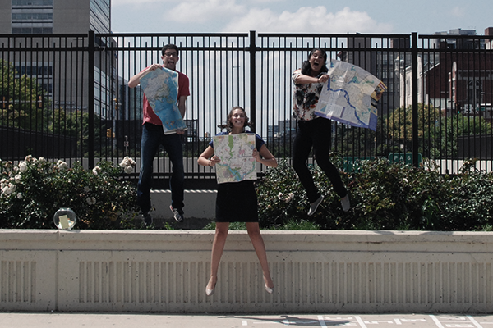
$5,000 Fellowship for Student GIS Analysts
Work on pro-bono projects for nonprofits
Mentored by Azavea Staff
More at Summerofmaps.com

Slide 8
Project Goals

Slide 9
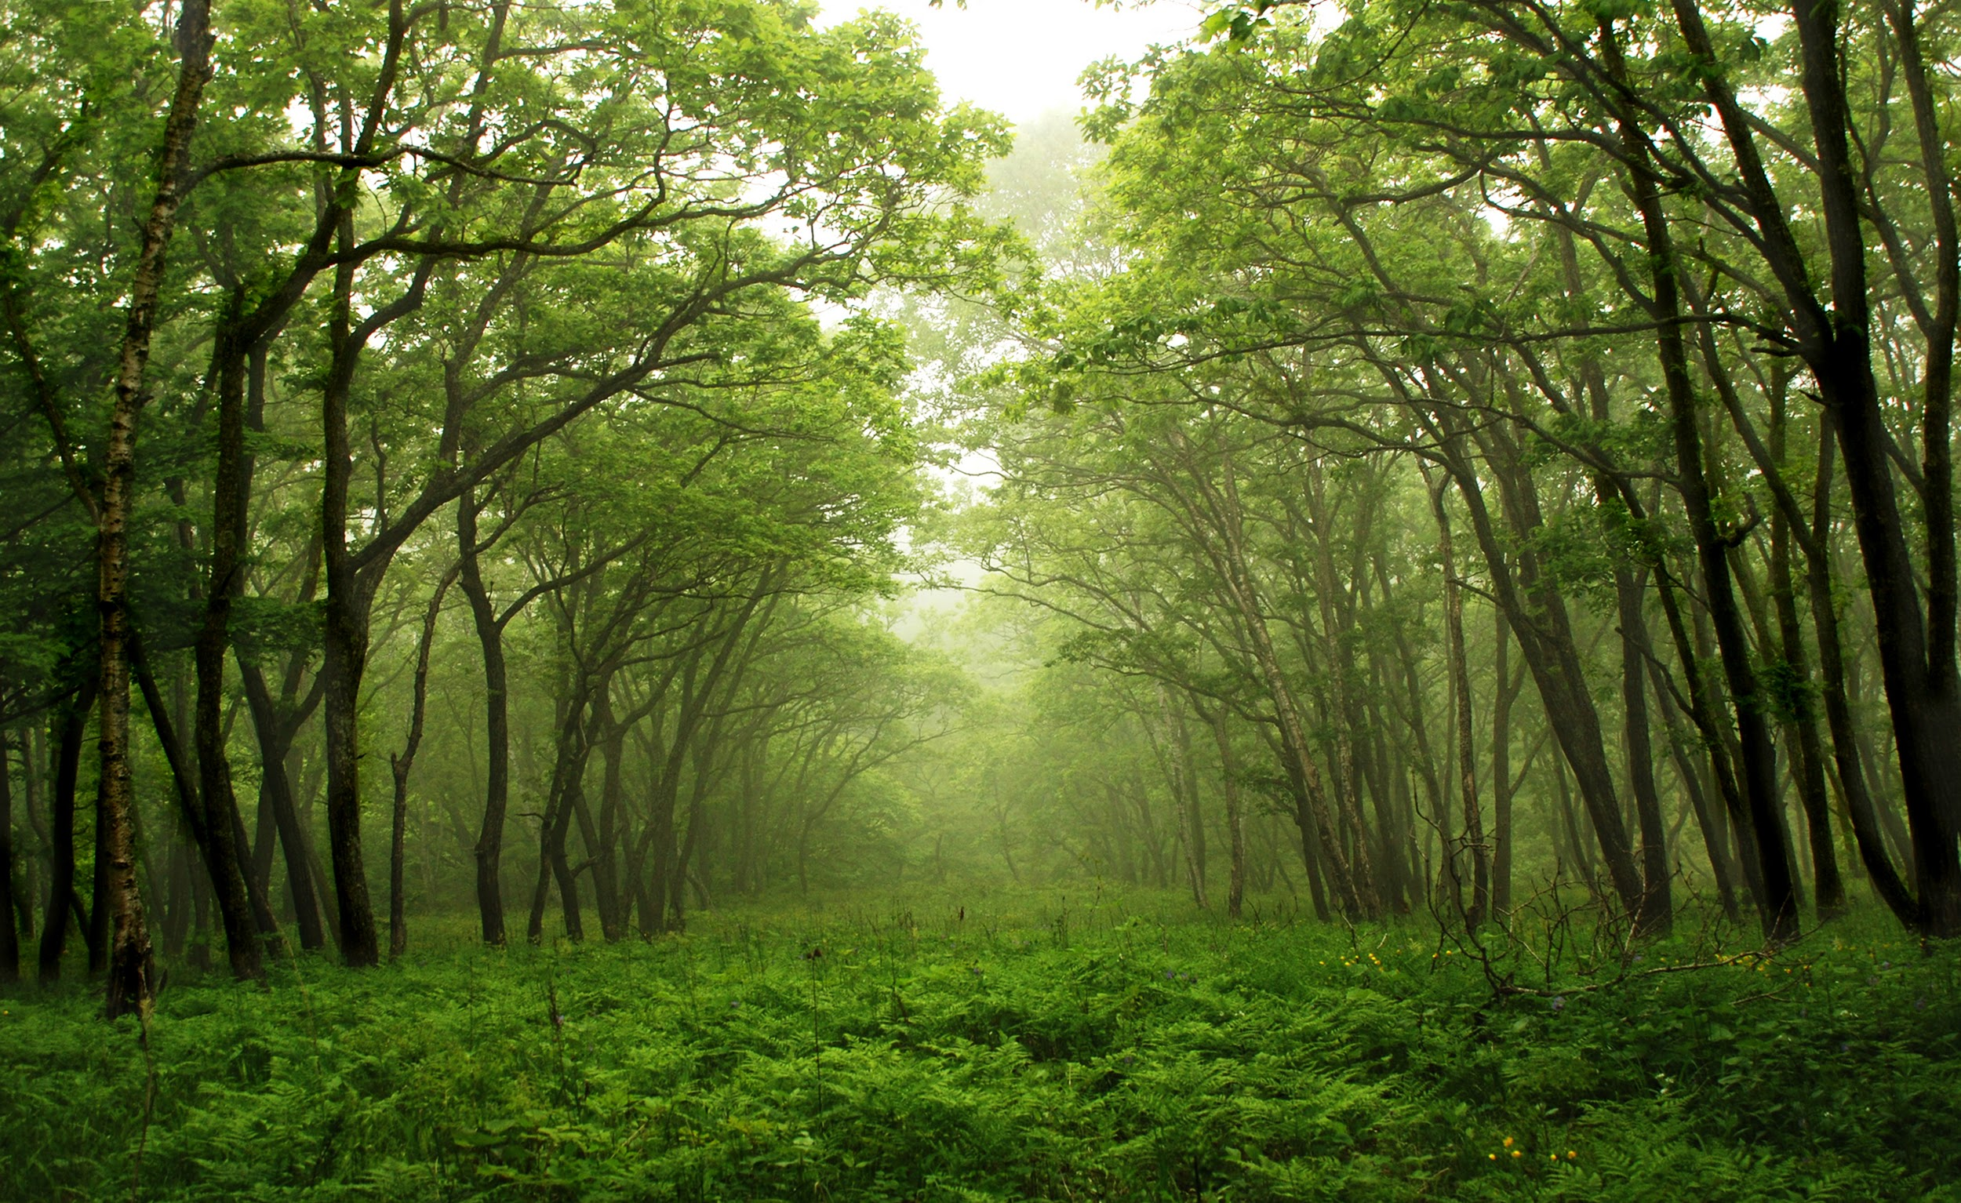
1. Analysis of Forest Cover

Slide 10
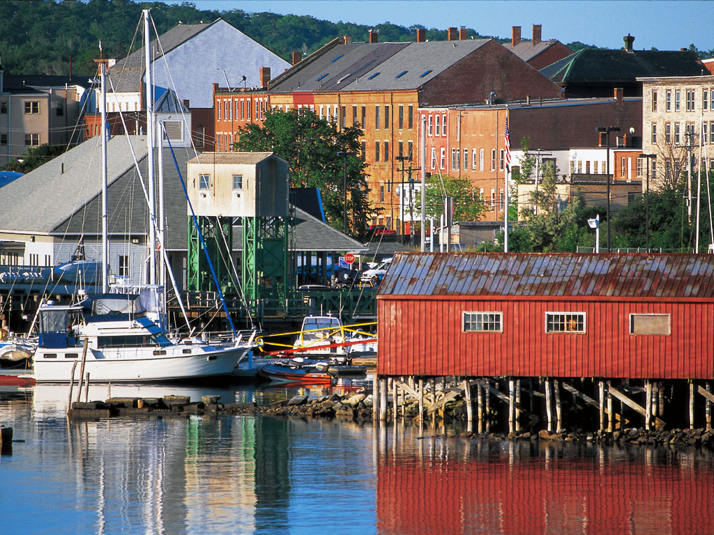
2. Analysis of Urban Growth

Slide 11
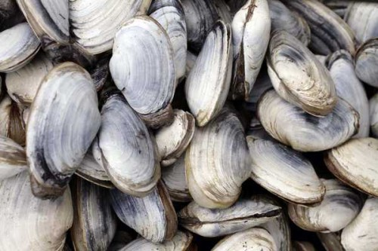
3. Impact on Bay Wildlife

Slide 12
Methods

Slide 13
Methods
Software: ArcGIS
Study Area: West Bay from Stockton Harbor to South Thomaston
Data Sources: Maine Office of GIS, NLCD, Friends of Penobscot Bay

Slide 14
National Land Cover Database (NLCD)
A comprehensive land cover dataset for the entire United States using satellite remote sensing technology
Advantages
Free
Pre-classified
Available for any geography
Notes:
Learn more at: http://pubs.usgs.gov/fs/2012/3020/fs2012-3020.pdf

Slide 15
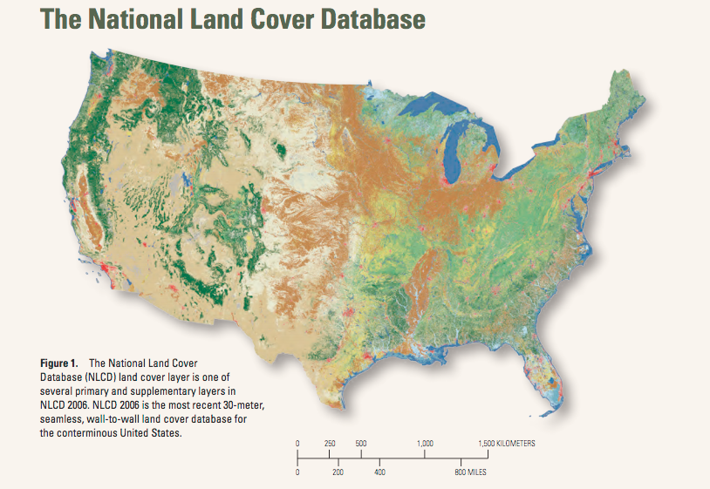
Land Cover Classifications
Water
Developed
Barren
Forest
Grassland
Agriculture
Wetlands
Notes:
John wesley powell, cadelilac desert mark risner

Slide 16
Penobscot Bay
Reference Map

Slide 17
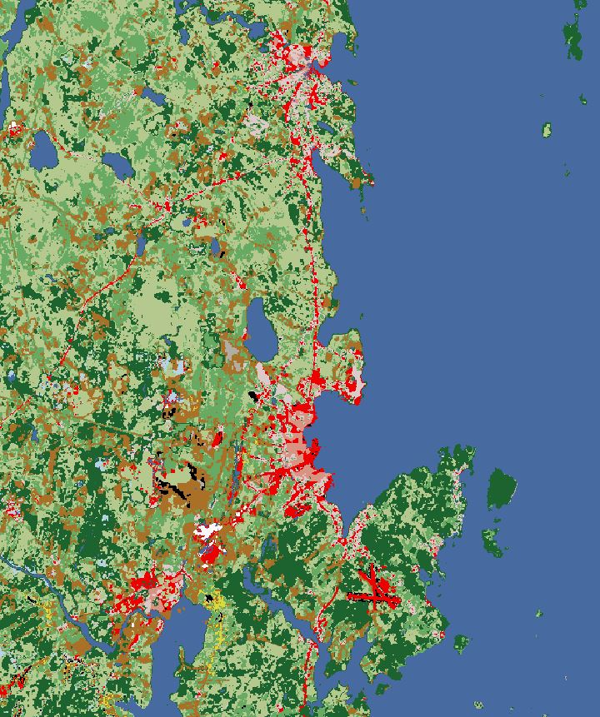
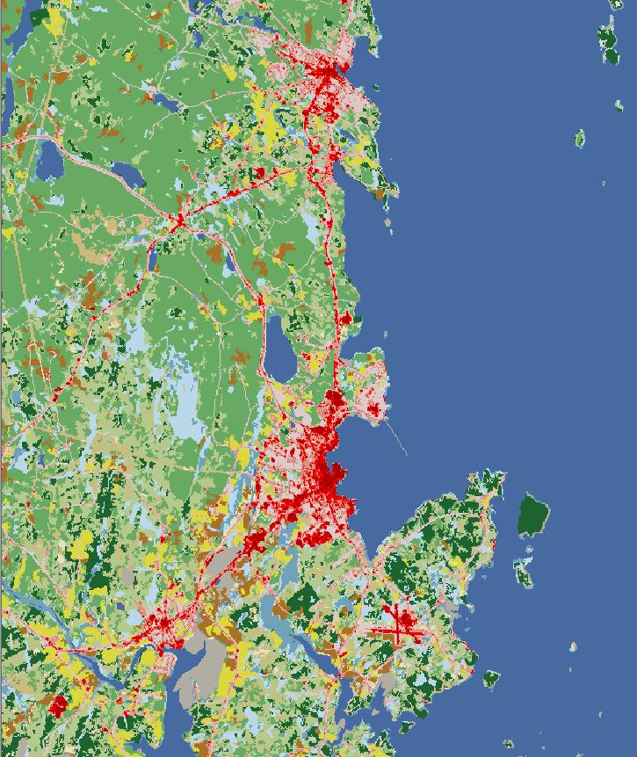

Slide 18
How was it used?
1.Calculating percent change
2.Cartographic Comparisons
3.Raster Differencing
4.Land Cover Transitions

Slide 19
Percent Change

Slide 20
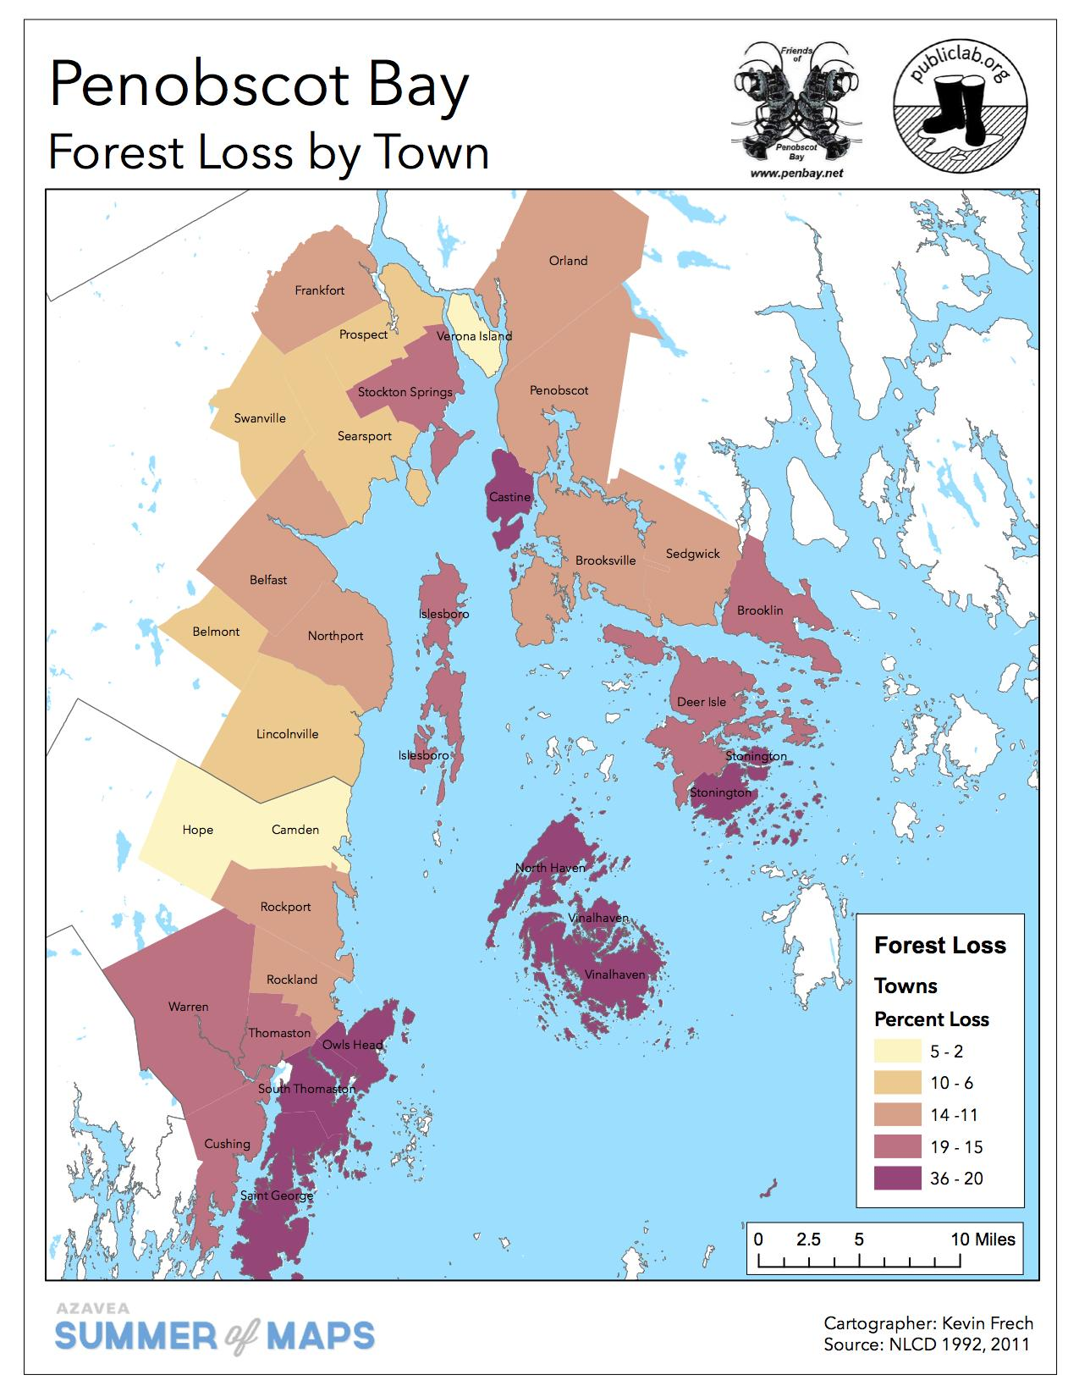

Slide 21
Cartographic
Comparison

Slide 22
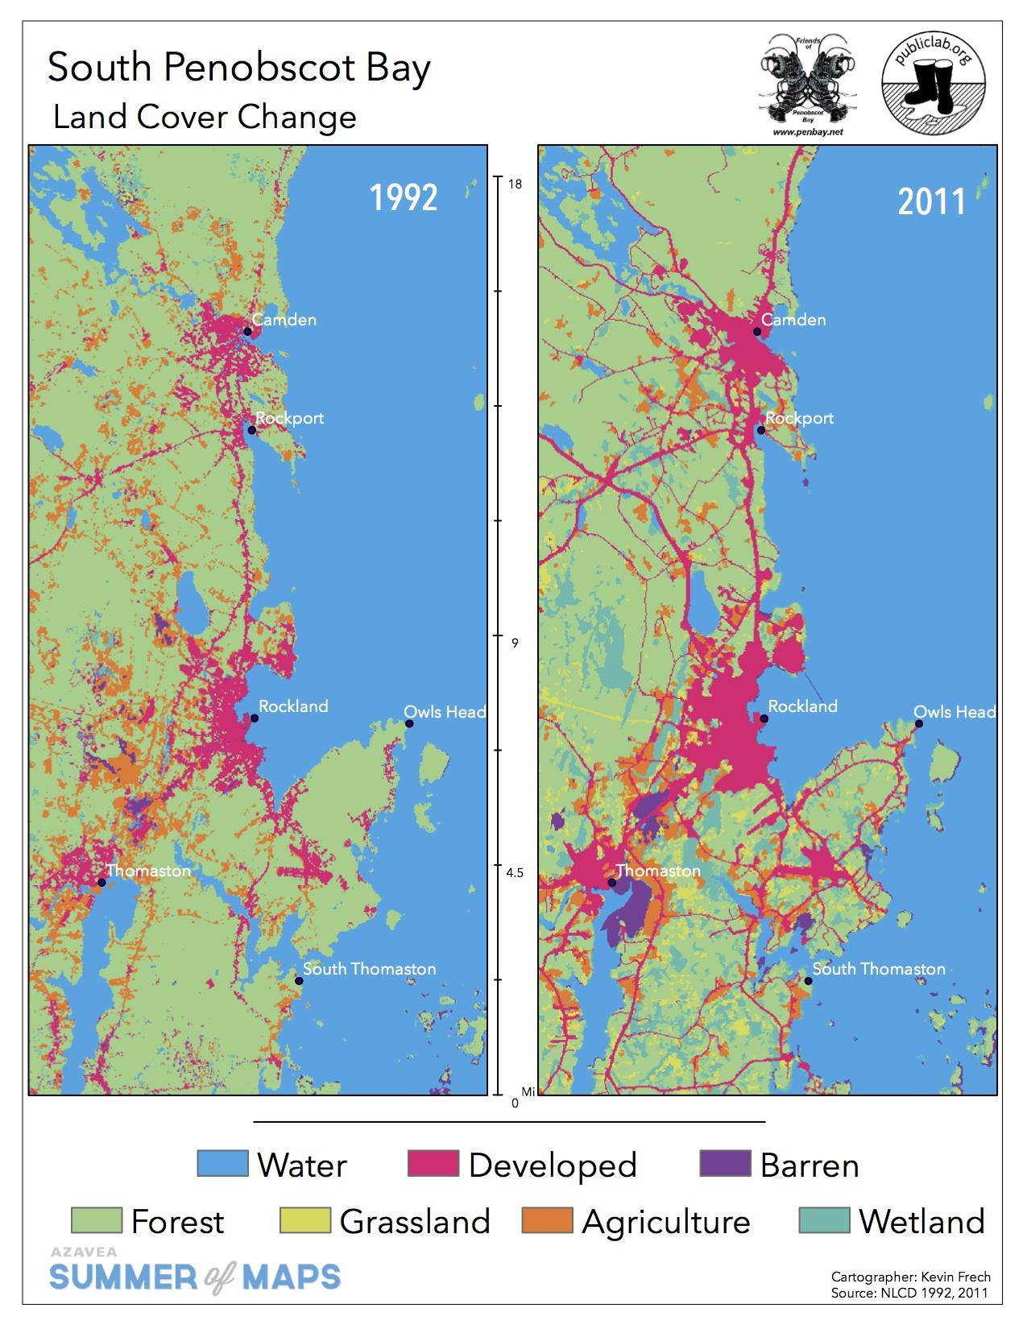

Slide 23
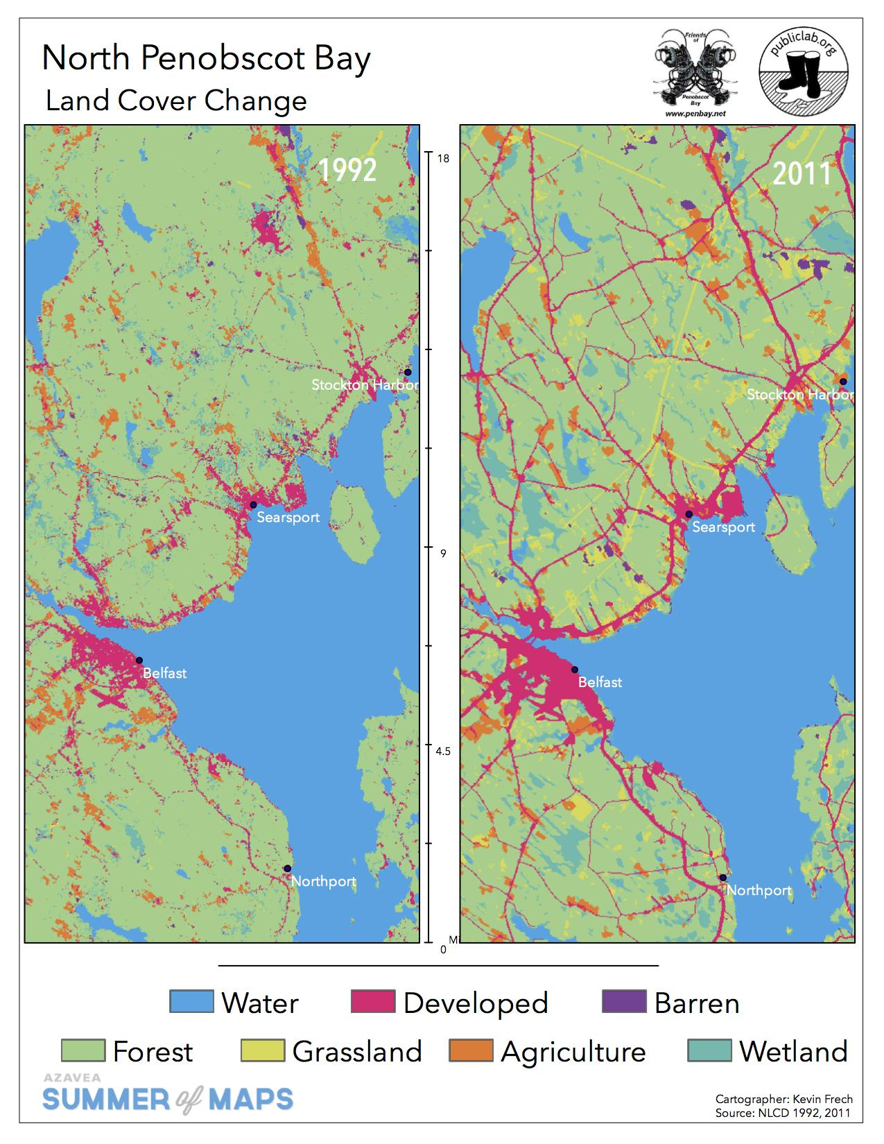

Slide 24
Raster
Differencing

Slide 25
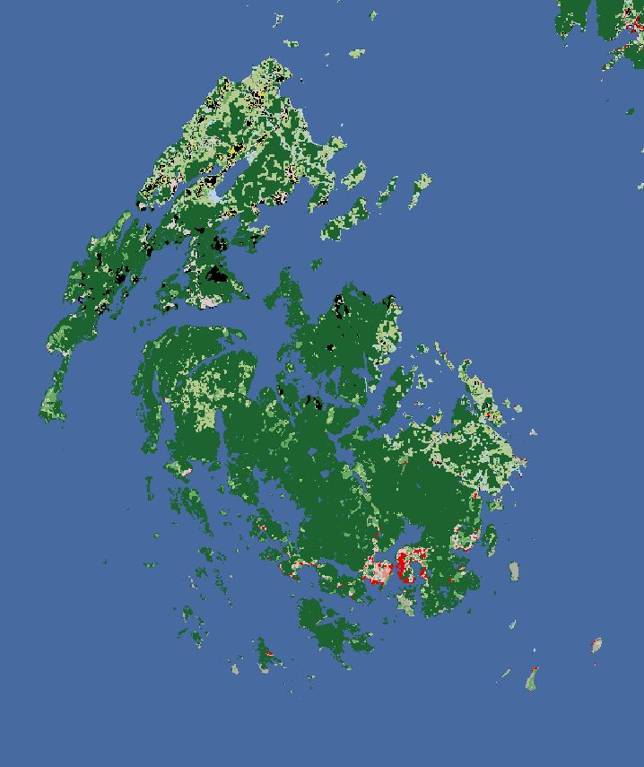
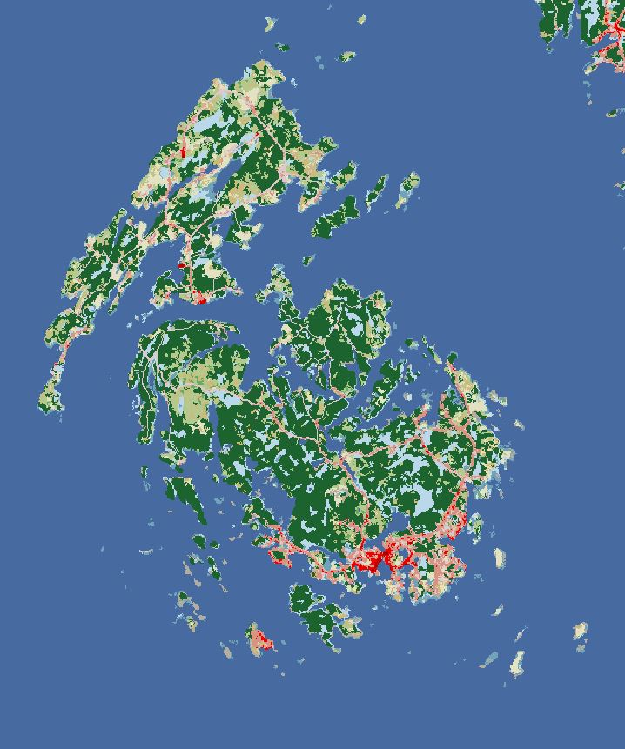

Slide 26
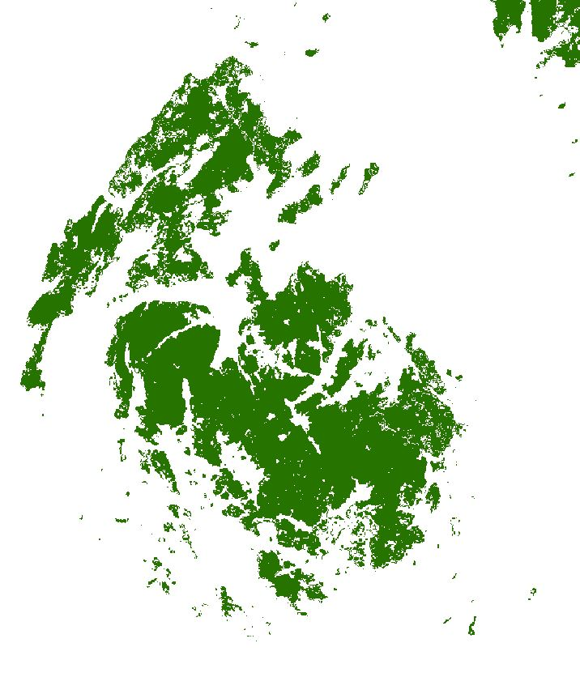
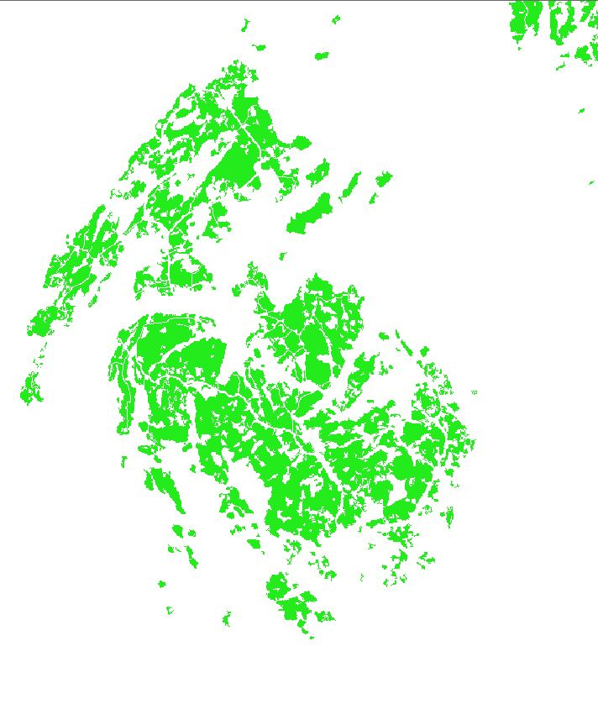

Slide 27
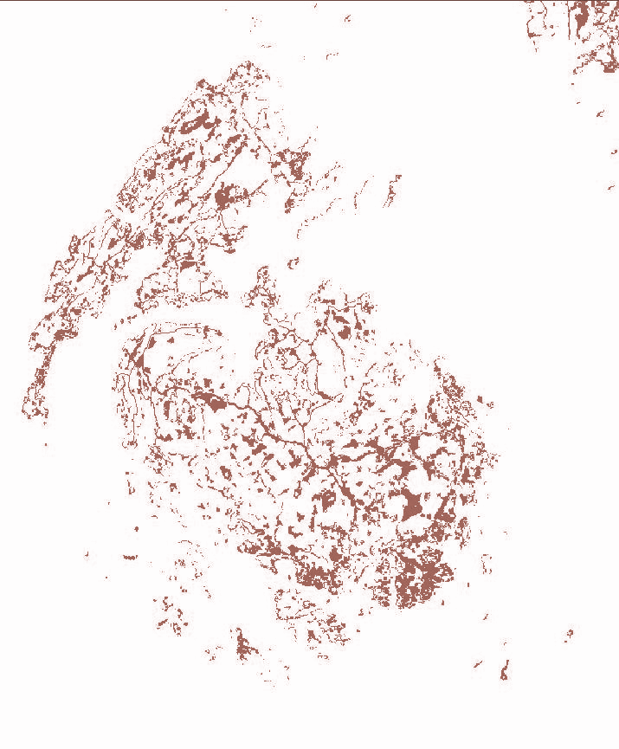

Slide 28
Land Cover
Transition

Slide 30
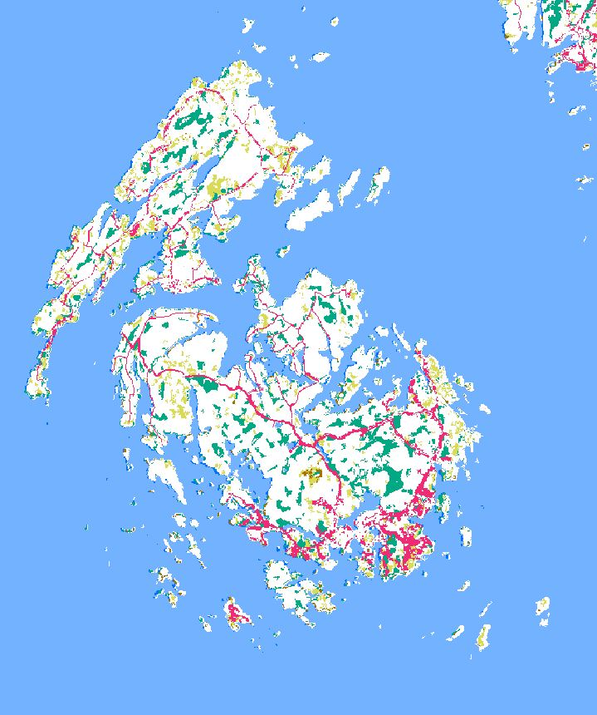

Slide 31
Results

Slide 32
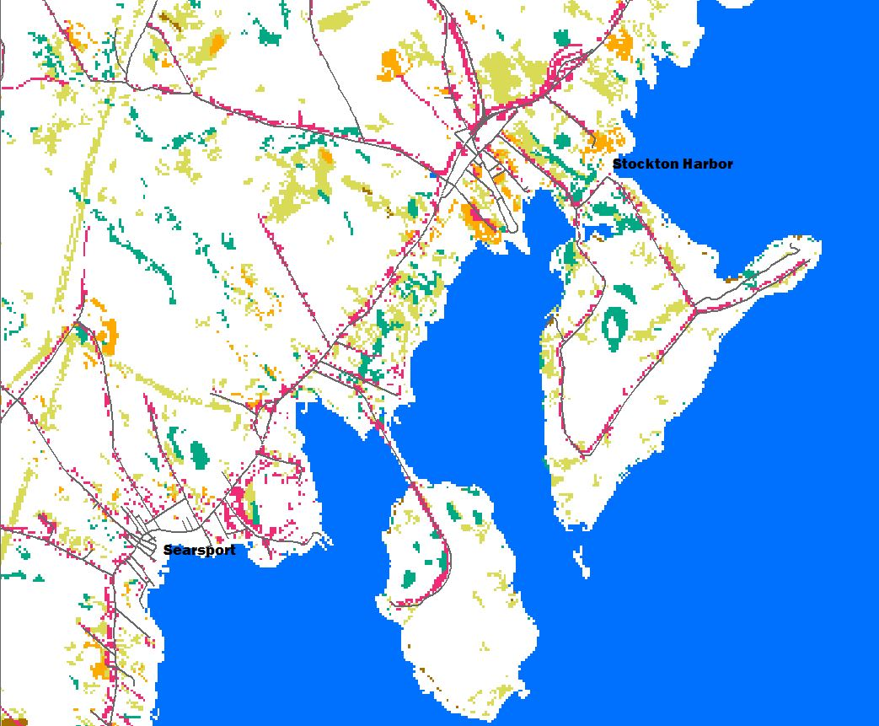
Searsport and Stockton Harbor
Land Cover | Change (Sq Mi) | Change (%)
Forest | 5.6 | -14%
Grassland | 3.7 | +1500%
Developed | 0.8 | +24%
Wetlands | 0.5 | +17%
Agriculture | 0.3 | +17%
Population | +84 | +2%
Forest -5.6
Developed +0.8
Grassland
Agriculture
Wetlands

Slide 33
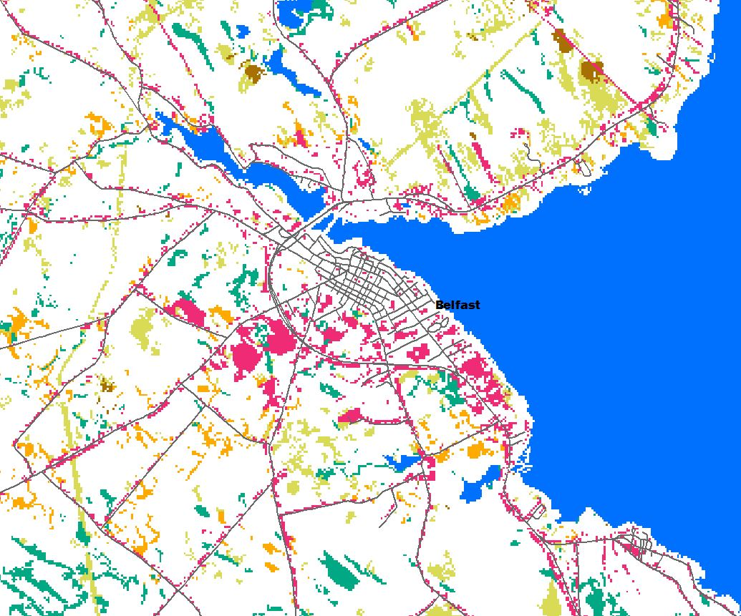
Belfast
Type | Change (Sq Mi) | Change (%)
Forest | 3.7 | -15%
Agriculture | 0.2 | -5%
Grassland | 1.9 | +800%
Developed | 1.7 | +44%
Wetlands | 0.9 | +50%
Population | +287 | +4.3%

Slide 34
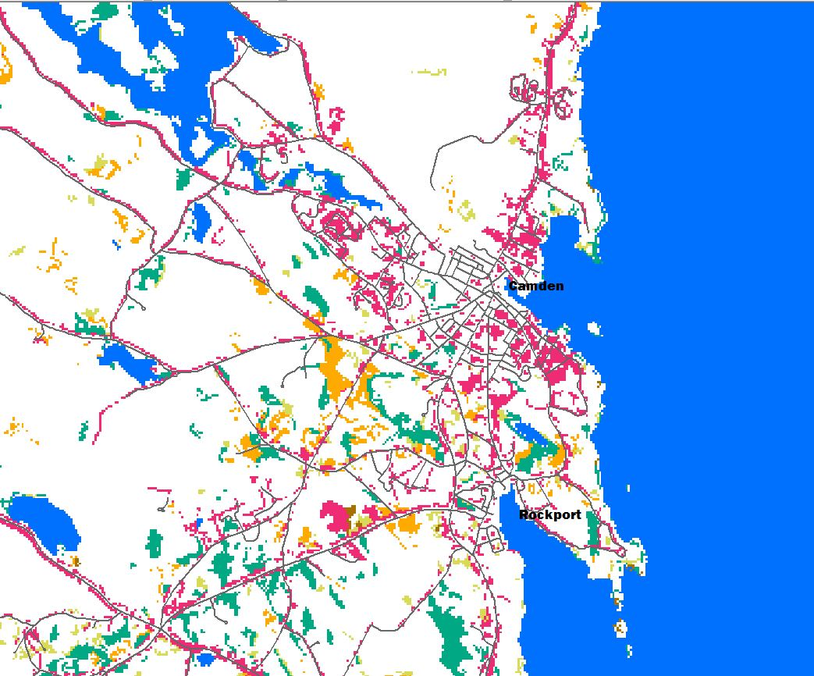
Camden and Rockport
Type | Change (Sq Mi) | Change (%)
Forest | 2.8 | -8%
Agriculture | 2.8 | -60%
Developed | 3.2 | +100%
Wetlands | 1.6 | +500%
Grassland | 1.1 | +5000%
Population | +72 | +0.1%

Slide 35
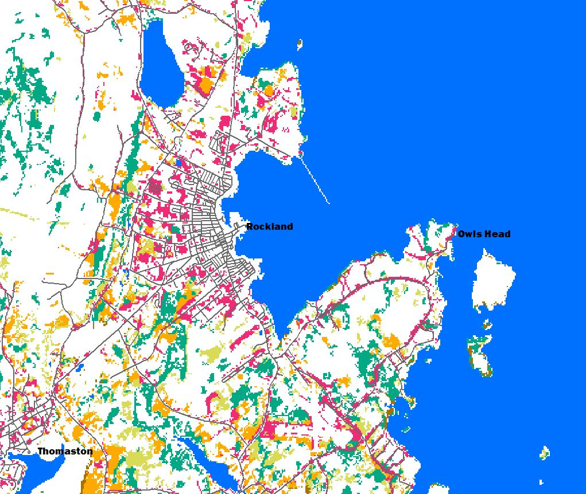
Rockland
Type | Change (Sq Mi) | Change (%)
Forest | 4.4 | -23%
Agriculture | 2.8 | -63%
Developed | 3.2 | +45%
Wetlands | 1.6 | +1000%
Grassland | 1.1 | NA
Population | -675 | -8%

Slide 36
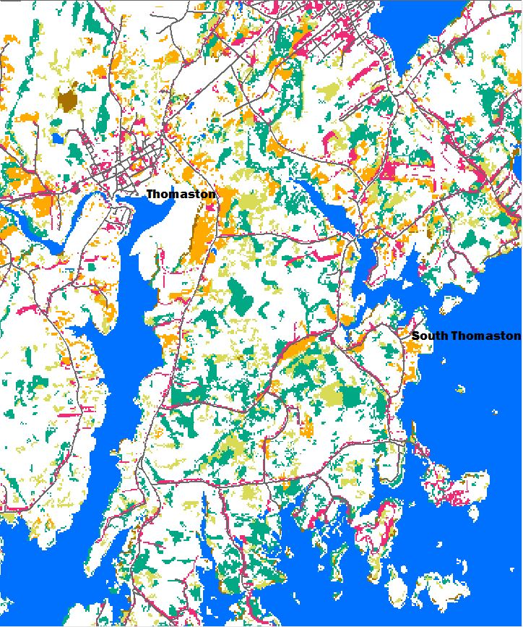
Thomaston
Type | Change (Sq Mi) | Change (%)
Forest | 5.9 | -37%
Agriculture | 0.4 | -10%
Wetlands | 2.9 | +1000%
Grassland | 2.0 | +1000%
Developed | 1.4 | 83%
Population | 525 | -16%

Slide 37
Vinalhaven
Type | Change (Sq Mi) | Change (%)
Forest | 5.9 | -22%
Developed | 0.8 | +250%
Grassland | 1.7 | +1000%
Agriculture | 0.0 | ~
Wetlands | 2.5 | +700%
Population | +87 | +8%

Slide 38
Conclusions

Slide 39
Forest Cover

Slide 40
Forest Cover
Substantial Deforestation in all Towns
Over 30 Square Miles
Average of 23% Loss
Emergence of Grasslands and Wetlands
+12 Square Miles of Grasslands
+13 Square Miles of Wetlands

Slide 41
Urban Growth

Slide 42
Urban Growth
Growth of developed land much higher than population growth
Average increase of 85%
Over 12 Square Miles
Average population decrease of 2%
Development largely for Tourism, Commercial, Industrial purposes

Slide 43
Impact on Bay Wildlife
Notes:
Underreported by 4x, so probably ~43K

Slide 44
Wildlife Reference Map

Slide 45
Recommendations for Further Research

Slide 46
Nexts Steps
EPA pollutants
Effect on wildlife
Demographic Research
censusreporter.org
Economic Impact
Is GDP increasing in line with development?
Creation of online web map as tool for data exploration

Slide 47
Why a Webmap?

Slide 48
Next Steps
QUESTIONS!

Slide 49
Thanks for listening!
KevinCFrech@gmail.com
@azavea
analytics.azavea.com
bit.ly/DGDGIS

